Slide 1
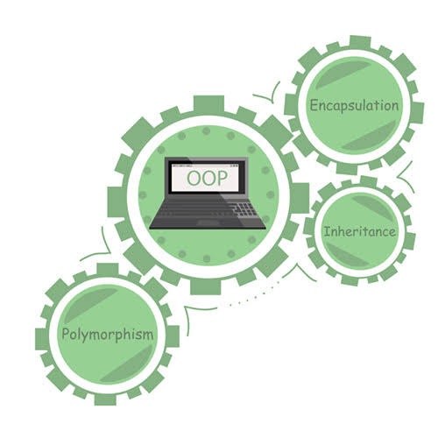

Object Oriented Paradigm
Topic: JAVA

Slide 2
Java User Input
scanf(“%d”,&age);
scanf(“%s”,name);
The Scanner class is used to get user input, and it is found in the java.util package.
To use the Scanner class,
Create an object of the class, and
Use any of the available methods found in the Scanner class documentation.
import java.util.Scanner;
OR
import java.util.*;
Inside main()
String s = "Hello, This is Java Class.";
//Create scanner Object and pass string in it
Scanner myObj = new Scanner(s);
System.out.println("String:" +myObj.nextLine());
Scanner myObj = new Scanner(System.in);
int age = myObj.nextInt();
String name = myObj.nextLine();
String: Hello, This is Java Class.

Slide 3
Scanner Methods
Method | What it Reads | Example Input | Variable Type
nextInt() | Whole number | 10, -5 | int
nextDouble() | Decimal number | 85.5 | double
nextFloat() | Decimal number | 3.14 | float
nextLong() | Large whole number | 123456789 | long
nextBoolean() | True / False | true | boolean
next() | One word | Java | String
nextLine() | Full sentence | I love Java | String

Slide 4

Content
JAVA User Input
Scanner Class
Control Statements
Selection Statements
Jump Statements
Loop Statements
Example Programs (4)

Slide 5
Program - 1
In your window, try getting user inputs: integer, Boolean, float, character.
import java.util.Scanner;
class MyClass {
public static void main(String[] args) {
Scanner myObj = new Scanner(System.in);
System.out.println("Enter name, age and salary:");
// String input
String name = myObj.nextLine();
// Numerical input
int age = myObj.nextInt();
double salary = myObj.nextDouble();
// Output input by user
System.out.println("Name: " + name);
System.out.println("Age: " + age);
System.out.println("Salary: " + salary);
}
}
Enter name, age and salary:
Mary
21
30000
Name: Mary
Age: 21
Salary: 30000

Slide 6
Control Statements
Control Statements
Selection Statements
Iteration Statements
Jump Statements
If…Else
Switch…Case
Break
Continue
While
Do…While
For

Slide 7
1️⃣ Decision (Selection) Statements
Statement | Meaning | Used When
if | Check one condition | Single condition
if–else | True or false | Two choices
else if | Multiple conditions | Many choices
switch | Multiple fixed options | Menu-based programs
2️⃣ Looping (Iteration) Statements
Loop | Meaning | Best Used When
for | Loop with fixed count | Known number of times
while | Loop with condition | Condition-based
do–while | Runs at least once | Must execute once
3️⃣ Jump (Branching) Statements
Statement | Purpose
break | Stop loop or switch
continue | Skip current iteration
return | Exit method

Slide 8
Selection Statements
IF-ELSE
if (condition)
{
// Executes this block if
// condition is true
}
else
{
// Executes this block if
// condition is false
}
IF
if(condition)
{
// Statements to execute if
// condition is true
}

Slide 9
Selection Statements
NESTED-IF
if (condition1)
{
// Executes when condition1 is true
if (condition2)
{
// Executes when condition2 is true
}
}
IF-ELSE-IF LADDER
if (condition)
statement;
else if (condition)
statement;
.
.
else
statement;

Slide 10
Selection Statements
SWITCH-CASE
switch (int|char)
{
case value1:
statement1;
break;
.
.
case valueN:
statementN;
break;
default:
statementDefault;
}

Slide 11
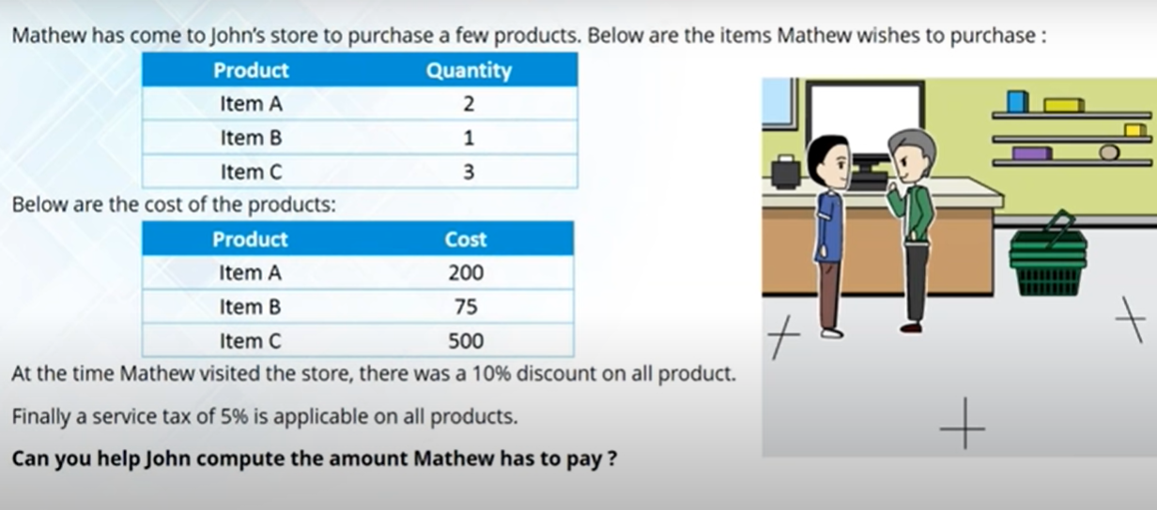
Program 2
Additional Discount of 5% if your final amount is greater than 1500.

Slide 12
retail_shop.java
public class retail_shop {
public static void main(String[] args) {
int itema=200, itemb=75, itemc=500;
double price;
price = ((itema*2)+(itemb)+(itemc*3));
price = price-(.1*price);
price = price + (0.05*price);
//System.out.println(price);
if(price > 1500)
price = price – (.05*price);
else
System.out.println(“Not eligible for discount”);
System.out.println(price);
}
}

Slide 13
Control Statements
Do-while
Why loops in Programming??
do{
//code to be executed
}while(condition);
To reduce code redundancies
Do While
Executes once and then repeats things until loop condition is true.
while
while(condition){
//code to be executed
}
Repeats things until loop condition is true.
For
While
for(init; condition; Incr/decr){
// code to be executed
}
Repeats things till the given number of times.
For

Slide 14
Jump Statements
Break
Syntax:
break;
To leave control from loop (for, while, do-while) based on specified condition.
Similarly from switch case.
Continue
Syntax:
continue;
If continue statement is true.
Any statement after continue will not get executed in that particular iteration of loop.

Slide 15
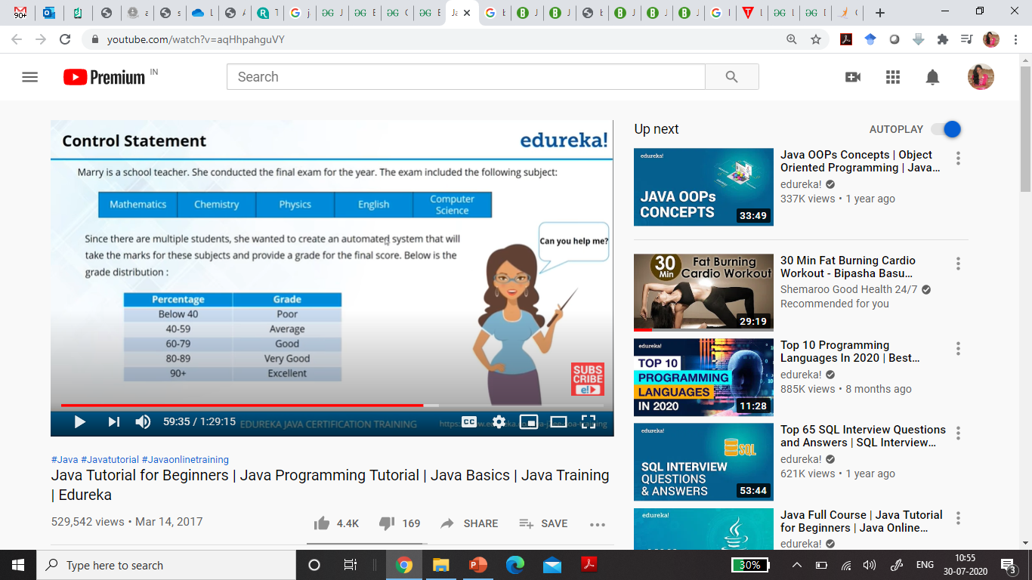
Program 3

Slide 16
Import java.util.Scanner*;
public class students_marks{
public static void main(String[] args) {
int maths, phy, che, eng, compsc;
double finalscore;
boolean result=true;
Scanner marks = new Scanner(System.in);
while(result)
{
System.out.println(“Enter Marks for Maths: “);
maths=marks.nextInt();
System.out.println(“Enter Marks for Phy: “);
phy=marks.nextInt();
System.out.println(“Enter Marks for Che: “);
che=marks.nextInt();
System.out.println(“Enter Marks for Eng: “);
eng=marks.nextInt();
System.out.println(“Enter Marks for CompSc: “);
compsc=marks.nextInt();
finalscore=(maths+eng+phy+che+compsc)/5;
if (finalscore >90)
System.out.println(“Excellent”);
else if (finalscore>80)
System.out.println(“V.Good”);
While
else if (finalscore>60)
System.out.println(“Good”);
else if (finalscore >40) System.out.println(“Average”);
else
System.out.println(“Poor”);
System.out.println(“Any more students?
(true or false)”);
result = marks.nextBoolean();
}
}
}

Slide 17
import java.util.*;
public class students_marks{
public static void main(String[] args) {
int maths, phy, che, eng, compsc;
double finalscore;
boolean result;
Scanner marks = new Scanner(System.in);
do
{
System.out.println(“Enter Marks for Maths: “);
maths=marks.nextInt();
System.out.println(“Enter Marks for Phy: “);
phy=marks.nextInt();
System.out.println(“Enter Marks for Che: “);
che=marks.nextInt();
System.out.println(“Enter Marks for Eng: “);
eng=marks.nextInt();
System.out.println(“Enter Marks for CompSc: “);
compsc=marks.nextInt();
finalscore=(maths+eng+phy+che+compsc)/5;
if (finalscore >90)
System.out.println(“Excellent”);
else if (finalscore>80)
System.out.println(“V.Good”);
else if (finalscore>60)
System.out.println(“Good”);
else if (finalscore >40) System.out.println(“Average”);
else
System.out.println(“Poor”);
Do-while
When to exit from loop?
System.out.println(“Any more students?
(true or false)”);
result = marks.nextBoolean();
} while(result);
}
}

Slide 18
Import java.util.*;
public class students_marks{
public static void main(String[] args) {
int maths, phy, che, eng, compsc, studentnumber;
double finalscore;
Scanner marks = new Scanner(System.in);
studentnumber = marks.nextInt();
for(int i=0; i<studentnumber; i++)
{
System.out.println(“Enter Marks for Maths: “);
maths=marks.nextInt();
System.out.println(“Enter Marks for Phy: “);
phy=marks.nextInt();
System.out.println(“Enter Marks for Che: “);
che=marks.nextInt();
System.out.println(“Enter Marks for Eng: “);
eng=marks.nextInt();
System.out.println(“Enter Marks for CompSc: “);
compsc=marks.nextInt();
finalscore=(maths+eng+phy+che+compsc)/5;
if (finalscore >90)
System.out.println(“Excellent”);
else if (finalscore>80)
System.out.println(“V.Good”);
For
else if (finalscore>60)
System.out.println(“Good”);
else if (finalscore >40) System.out.println(“Average”);
else
System.out.println(“Poor”);
}
}
}
When you know total number of students in class.

Slide 19
THANK YOU….

